Slide 1
Intellectual Property in Cyberspace
ELEG 491

Slide 2
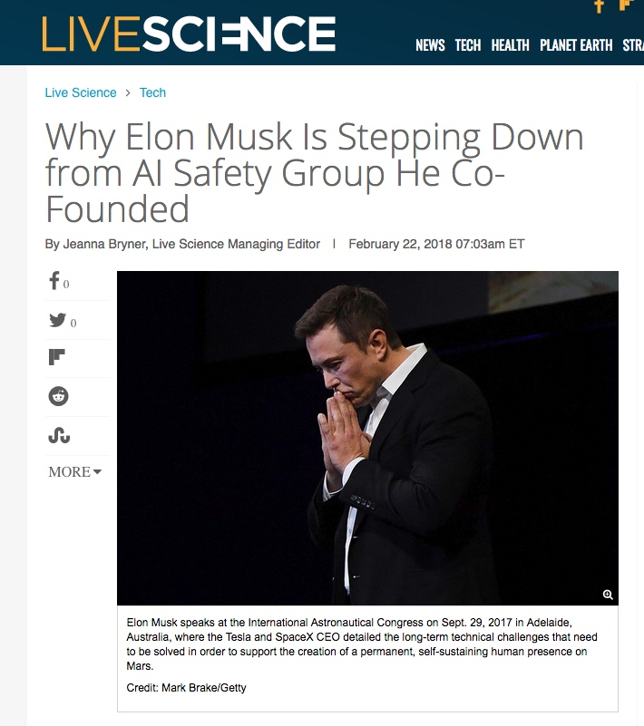
Like other topics, IP is connected to privacy, safety, security, etc.

Slide 3
What do we want from IP law?
From a rights perspective, we want protection of legitimate individual claims of property.
John Locke’s view of property: A claim on the fruits of labor on things taken from “the commons”

Slide 4
The dominant (Western) view about property and rights
John Locke, Second Treatise on Civil Government, chapter 5, sections 25-31
Of Property
“[I]t is very clear, that God … has given the earth to the children of men [and] to mankind in common. But this being supposed, it seems to some a very great difficulty, how any one should ever come to have a property in any thing. But I shall endeavour to shew, how men might come to have a property in several parts of that which God gave to mankind in common, and that without any express compact of all the commoners….
The earth, and all that is therein, is given to men for the
support and comfort of their being. And tho' all the fruits it naturally
produces, and beasts it feeds, belong to mankind in common, as they are
produced by the spontaneous hand of nature; and no body has originally a private dominion, exclusive of the rest of mankind, in any of them, as they are thus in their natural state: yet being given for the use of men, there must of necessity be a means to appropriate them some way or other, before they can be of any use, or at all beneficial to any particular man. “

Slide 5
Locke (cont.)
“Though the earth, and all inferior creatures, be common to all men,
yet every man has a property in his own person: this no body has any right to but himself. The labour of his body, and the work of his hands, we may say, are properly his. Whatsoever then he removes out of the state that nature hath provided, and left it in, he hath mixed his labour with, and joined to it something that is his own, and thereby makes it his property. It being by him removed from the common state nature hath placed it in, it hath by this labour something annexed to it, that excludes the common right of other men: for this labour being the unquestionable property of the labourer, no man but he can have a right to what that is once joined to, at least where there is enough, and as good, left in common for others….”
(the last part is the “Lockean Proviso”)

Slide 6
From an “economics of law” view, we want the optimal mix of protection of “fences” and “codes” (Lessig):
“From a social perspective, we would want the mix that provides optimal protection at the lowest cost. (In economics-speak, we would want a mix such that the marginal cost of an additional unit of protection is equivalent to the marginal benefit.)”
[Code, Ch. 10]

Slide 7
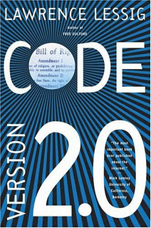
You can learn more about Lessig’s views…for free!

Slide 8
Intellectual Property Protection: 4 Schemes & durations
Copyrights (life of author + 70 years)
Patents (20 years past filing date)
Trademarks (length of use)
Trade secrets (length of secrecy)

Slide 9
Federal Legal Protections: Balance
In the US Constitution (Article 1, Section 8) states:
“The congress shall have the power... to promote the Progress of Science and the useful Arts, by securing for limited Times to authors and inventors the exclusive Rights to their respective Writings and Discoveries.”
(bold added: the basis of the “balancing” view)

Slide 10
Lessig’s 4 modes of regulation
Norms
Markets
Codes (real and software)
Law (only necessary when others fail)

Slide 11
Lessig’s examples:
• I have a stack of firewood behind my house. No one steals it. If I left my bike out overnight, it would be gone.
• A friend told me that, in a favorite beach town, the city used to find it impossible to plant flowers—they would immediately be picked. But now, he proudly reports, after a long “community spirit” campaign, the flowers are no longer picked.
• There are special laws about the theft of automobiles, planes, and boats. There are no special laws about the theft of skyscrapers. Cars, planes, and boats need protection. Skyscrapers pretty much take care of themselves.

Slide 12
Why Property Laws are Important
Property Laws establish relationships between:
individuals,
different sorts of objects,
the state (police and the courts, etc.)

Slide 13
What Is (Tangible) Property?
‘Property’ typically refers to tangible items.
Originally, ‘property’ referred to land.
Property now also includes:
automobiles
articles of clothing
a video collection
a company’s label

Slide 14
Intellectual Objects
‘intellectual object’ can refer to various forms or instances of intellectual property.
Intellectual property consists of “objects” that are not tangible.
Intellectual objects represent creative works and inventions, i.e., the “fixing” or expressions of ideas.

Slide 15
Intellectual vs. Tangible Objects
Tangible objects are excludable and rivalrous in nature. (If I own an apple, you can’t own it, and thus I can “exclude” your access to it. If I eat it, you can’t also eat it—there is less apple to go around)
Intellectual objects, such as software programs, are non-excludable. Are they non-rivalrous?

Slide 16
Intellectual vs. Tangible Objects (continued)
Scarcity applies to tangible objects (in markets this gives rise to competition and rivalry)
Scarcity need not exist for intellectual objects; intellectual objects can be easily reproduced.

Slide 17
Ownership of Intellectual vs. Tangible Objects
Legally, one cannot own an idea in the same sense that one can own a physical object. Governments do not grant ownership rights to individuals for ideas per se.
Legal protection is given only to the tangible expression of an idea that is creative or original.

Slide 18
Ideas vs. Expressions of Ideas
If an idea is literary or artistic in nature, it must be expressed (or "fixed") in some tangible medium in order to be protected. This is copyright.
Functional ideas, such as an inventions, must be expressed in terms of a machine or a process. This is patent.
Authors are granted copyright protections for expressions of their “literary” ideas.
Inventors are given patent protection for their inventions.

Slide 19
Jefferson: we cannot own ideas
“If nature has made any one thing less susceptible than all others of exclusive property, it is the action of the thinking power called an idea, which an individual may exclusively possess as long as he keeps it to himself; but the moment it is divulged, it forces itself into the possession of every one, and the receiver cannot dispossess himself of it. Its peculiar character, too, is that no one possesses the less, because every other possess the whole of it. He who receives an idea from me, receives instruction himself without lessening mine… That ideas should freely spread from one to another over the globe, for the moral and mutual instruction of man, and improvement of his condition, seems to have been peculiarly and benevolently designed by nature, when she made them, like fire, expansible over all space, without lessening their density at any point... Inventions then cannot, in nature, be a subject of property.”
Thomas Jefferson, Letter to Isaac McPherson, Monticello, August 13, 1813

Slide 20
The Bayh-Dole Act (1980, 2018)
Establishes IP rules between Fed. Gov’t and “contractors”
Allows universities to own IP from research
Allows Gov’t to use IP that they fund free of charge
Requires scientists to claim title to discoveries or risk losing that property

Slide 21
Why Protect Intellectual Property?
One answer is: “Our current laws say that intellectual property should be protected.”
But on what philosophical grounds are our property laws themselves based?
“Natural Rights”
Consequentialist reasons (utilitarian).

Slide 22
Software as Intellectual Property
Should computer programs be eligible for patent protection?
How did they get protected by copyright law?
Do they deserve both, or perhaps neither, kind of protection?
Computer software consist of lines of programming code (or codified thought).
It is not expressed or "fixed" in a tangible medium in the same way that literary works are.

Slide 23
Software as Intellectual Property (continued)
Software programs also resemble algorithms, which, like mathematical ideas or "mental steps," are not eligible for patent protection.
Eventually, however, both copyright and patent protections were granted to software programs.

Slide 24
Copyright Protection
Copyright holders have the exclusive right to:
make copies of the work;
produce derivative works, translations into other languages, movies based on the book, and so forth;
distribute copies;
perform works in public (musicals, plays. etc.);
display works in public (e.g., art works).
Fair use and First Sale doctrines apply

Slide 25
The Fair Use Provision in Copyright Law
Fair use balances the exclusive controls given to copyright holders against the broader interests of society (remember Art. 1 Sec.8)
Fair use means that someone may make limited use of another person's copyrighted work for purposes such as:
criticism,
comment,
teaching,
scholarship,
research.
Fair use also supports "reverse engineering.”

Slide 26
Evolution of U.S. Copyright Law
The first copyright law was enacted in 1790.
It applied primarily to books, maps, and charts.
The law was later extended to include newer forms of media such as photography, movies, audio recordings, etc.
In 1909, the copyright law was amended to include any "form that could be seen and read visually" by humans.
This change was in response to a new technology: the player piano case, the origin of the "machine readable" vs. "human readable" distinction. See White-Smith v. Apollo, 1908

Slide 27
Evolution of Copyright Law in the U.S. (Continued)
Source code can be read by humans.
Executable code cannot be read by humans. Does it enjoy copyright?
Does the compiler violate copyright?
Beginning in the 1960s, arguments were made that computer programs should be eligible for copyright protection. What “part” is protected?

Slide 28
Evolution of Copyright Law in the U.S. (Continued)
A computer program was defined under the US Copyright Act (1976) as
“a set of statements or instructions to be used directly in a computer in order to bring about certain results.”
The case Sony v. Universal Studios (1984) establishes the loophole of “non-infringing use” for copying technologies.

Slide 29
Evolution of Copyright Law in the U.S. (Continued)
In 1998, two important amendments were made to the 1976 Copyright Act:
Sonny Bono Copyright Term Extension Act (SBCTEA) extended the length of copyright protection from the life of the author plus 50 years to the life of the author plus 70 years.
2) Digital Millennium Copyright Act (DMCA), contains a controversial "anti-circumvention clause”:
forbids the development of any software or hardware technology that circumvents (or devises a technological workaround) to copyrighted digital media.
3) DMCA “takedown notices” are issued to ISPs—part of the liability exemption clause

Slide 30
The Original Napster Case
Napster (1999) was sued by the Recording Industry Association of America (RIAA) for distributing copyrighted music on the Internet through a centralized server.
Gnutella, Morpheus, and KaZaA also distributed copyrighted music on the Internet, but unlike Napster, these services used a “decentralized” system.
Courts ruled against Napster (2001). Napster went commercial, became Roxio and then Rhapsody.

Slide 31
Patent Protections
A patent is a form of legal protection given to individuals who create an invention or process.
Unlike copyrights, patents offer a 20-year exclusive monopoly over an expression or implementation of a protected work.

Slide 32
Patents (Continued)
Patent protection can be applied to inventions and discoveries that include useful or functional devices such as machines, “articles of manufacture,” or "compositions of matter.“
Patents are granted to inventions and discoveries that satisfy three conditions:
usefulness,
novelty,
non-obviousness.
NOTE: U.S. is now a “first to file” country, like all the rest.

Slide 33
Patents (Continued)
Computer hardware enjoys patent protection.
Computer software did not (initially).
Gary Benson applied for a patent for an algorithm he developed that translated the representation of numbers from base 10 to base 2. Benson’s algorithm is an important feature of all programs.
If he had been granted a patent for his algorithm, Benson would have controlled almost every computer in use for 12 years.
With Gotshalk v. Benson (1972), the U.S. Patent Office and the courts established a strong opposition to patents for software.

Slide 34
The Diamond v. Diehr Case
The Diamond v. Diehr (1981) case is a landmark ruling for patenting software—protected the first patent awarded for a computer program.
In this instance, the computer program assisted in a process of converting rubber into tires.

Slide 35
Jurisdictional Issues Involving IP Laws
Intellectual property (IP) laws enacted in the U.S. have implications that are global.
Some international treaties for IP have been signed, such as TRIPS (Trade Relationship aspects of Intellectual Property Standards).
The TRIPS agreement implemented requirements from the Berne Convention for the Protection of Literary and Artistic Works.
TRIPS is recognized by signatories to the World Intellectual Property Organization (WIPO).

Slide 36
Challenges to the “balancing” view: Free Software Foundation (FSF)
FSF was formed in 1985 to support of Stallman’s GNU project. According to FSF, four “freedoms” are essential for free software, i.e., the freedom to:
run the program, for any purpose;
study how the program works, and adapt it for your needs;
redistribute copies so you can help your neighbor;
improve the program, and release your improvements to the public so that the whole community benefits.
NOW part of the Electronic Frontier Foundation

Slide 37
“Information Wants to Be Shared”
The original computing and Internet environments were governed by an implicit principle of sharing information. For example:
Doug Englebart’s mouse (no patent)
Tim Berners-Lee’s HTML code (no copyright)
Some people have taken the idea of “sharing” very seriously…e.g., the case of Aaron Swartz and JSTOR

Slide 38
More challenges: The Creative Commons (CC)
The Creative Commons (CC), a nonprofit organization, was launched by Lawrence Lessig and others in 2001.
CC aims at providing creative solutions to problems that current copyright laws pose for sharing information.
CC expands the range of creative work available to others legally to build upon and share.

Slide 39
CC (Continued)
The CC menu provides four options:
Attribution—Permit others to copy, distribute, display, and perform the work and derivative works based upon it only if they give you credit;
Noncommercial—Permit others to copy, distribute, display, and perform the work and derivative works based upon it only for noncommercial purposes;
Derivative works—Permit others to copy, distribute, display, and perform only verbatim copies of the work, not derivative works based upon it;
Share alike—Permit others to distribute derivative works only under a license identical to the license that governs your work.

